Slide 1
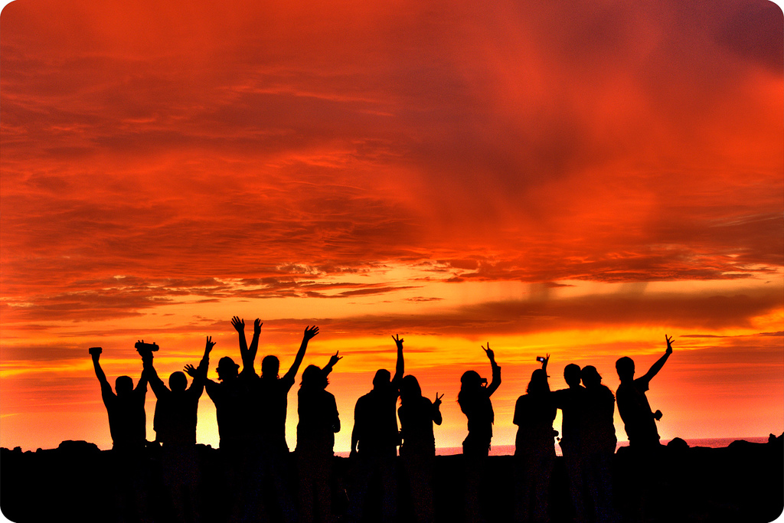
Leveraging the Legacy: Reigniting Commitment to Middle School Ideals
A World Café hosted by
Tracy W. Smith and Nancy Doda
Table hosts: John Lounsbury, Ed Brazee, Paul George, Howard Johnston, Patti Kinney, Ken McEwin, Mark Springer

Slide 2
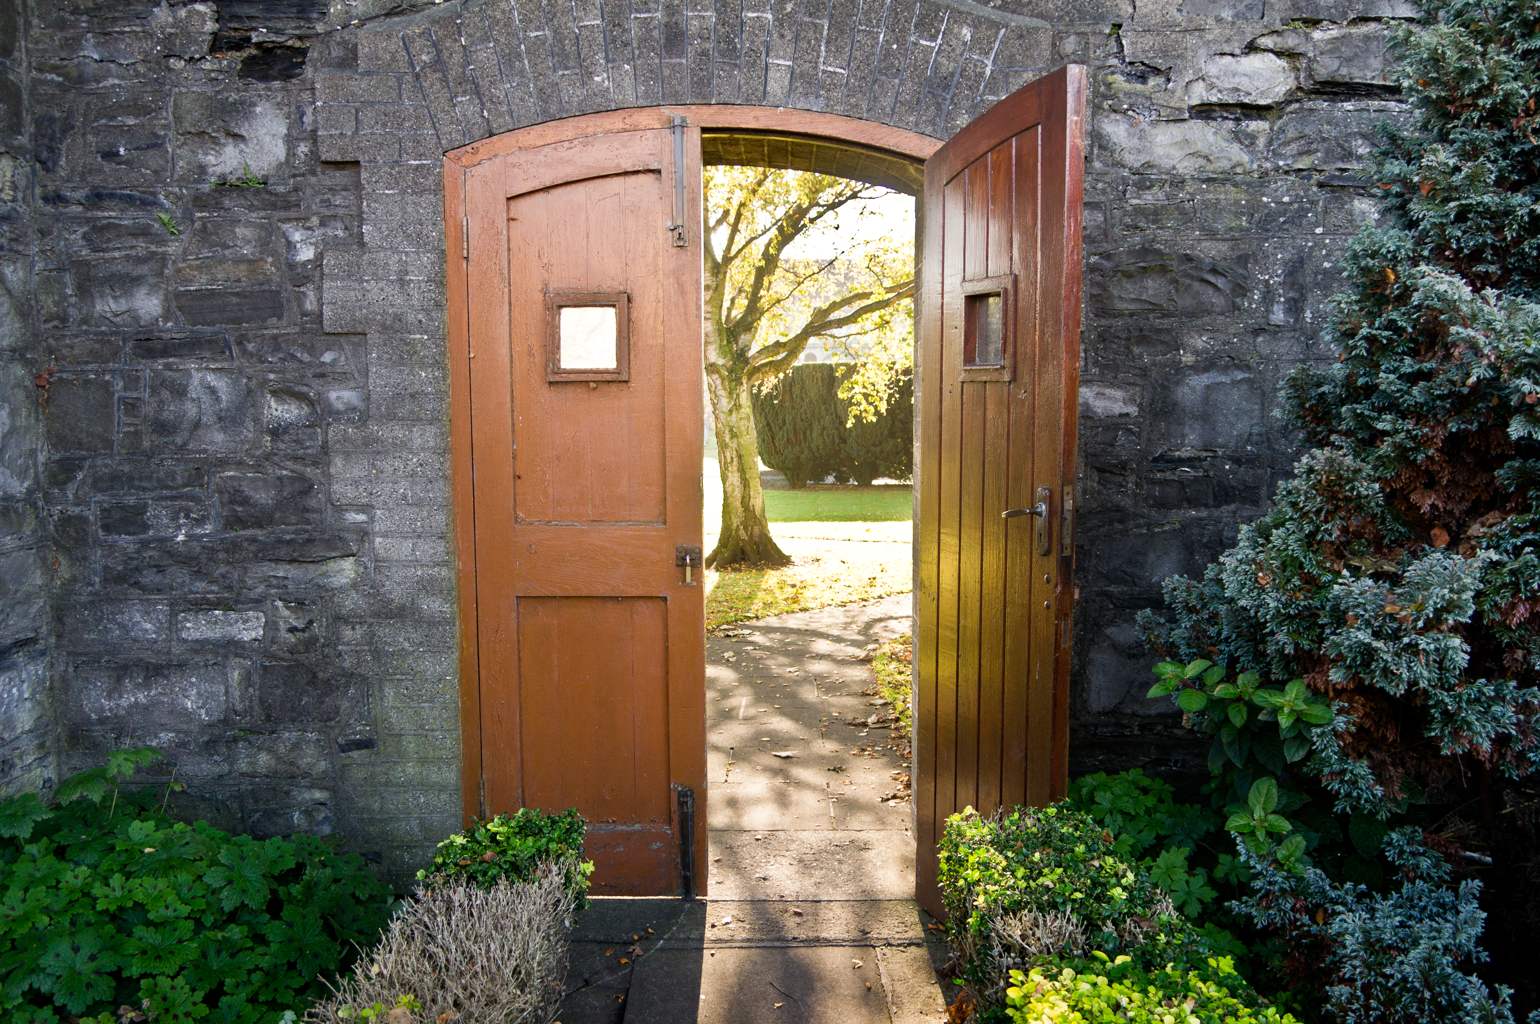
World Café
“We learn, adapt, and bring forth our worlds through the networks of conversation in which we participate.”
- Humberto Maturana
Photo Credit: William Murphy, Flickr

Slide 3
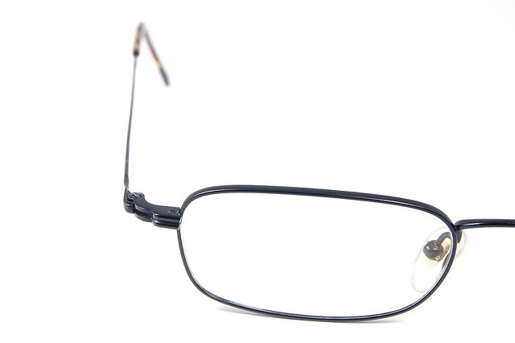
Why Invite Conversations?
“It’s never enough just to tell people about some new insight. Rather, you have to get them to experience it in a way that evokes its power and possibility. Instead of pouring knowledge into people’s heads, you need to help them grind a new set of eyeglasses so they can see the world in a new way.”
–John Seeley Brown
“What’s in a question, you ask? Everything. It is a way of evoking stimulating response or stultifying inquiry. It is, in essence, the very core of teaching.”
–John Dewey (1933)

Slide 4
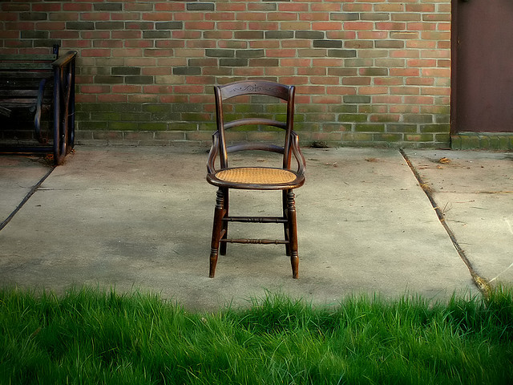
Conversation and World Café
Meetings designed with the minimal structure necessary to sustain relevant conversations and include criteria for what’s make a good question, including:
  Open  Inviting  Honest  Experiential  Inclusive  Generative  Relevant

Slide 5
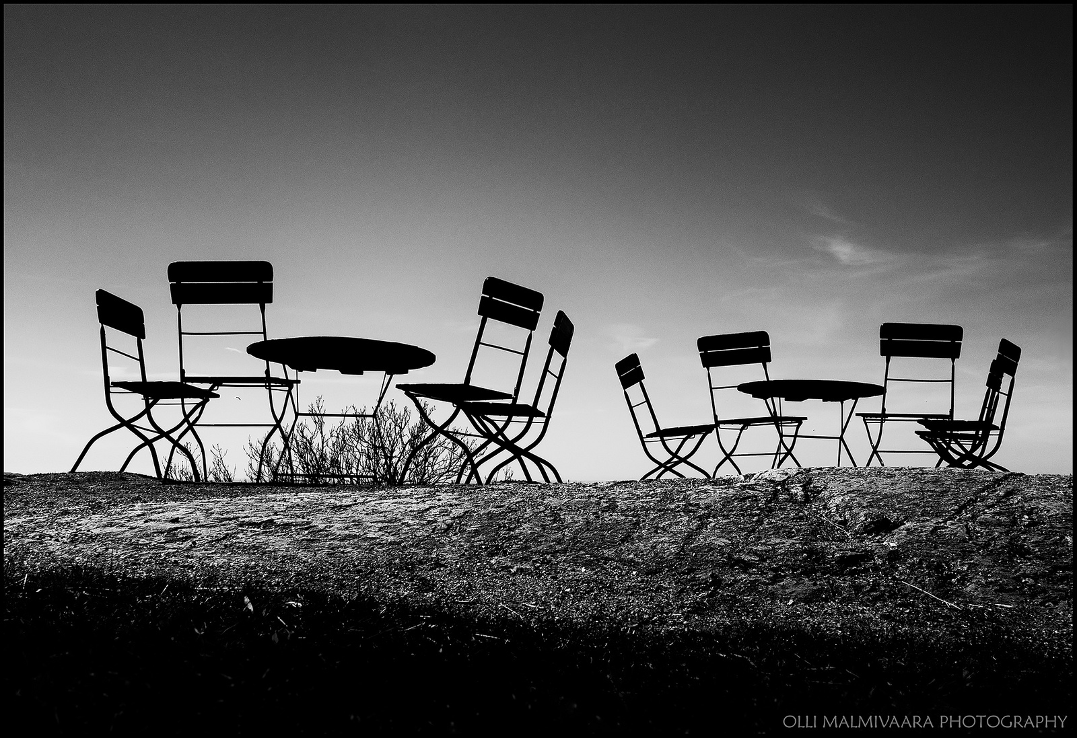
World Café or Café Conversations

Slide 6

History of World Café
1995: Mill Valley, California
A small group of business and academic leaders were meeting in a home. Rain disrupted their plan for a large-circle dialogue.
The two dozen participants spontaneously formed into small, intimate table conversations about the questions that had drawn them together.
Recorded their insights on makeshift tablecloths.
Periodically switched or combined tables so stronger ideas could be shared further and patterns in thinking could come to life.
Photo Credit: jdmuth, Flickr

Slide 7
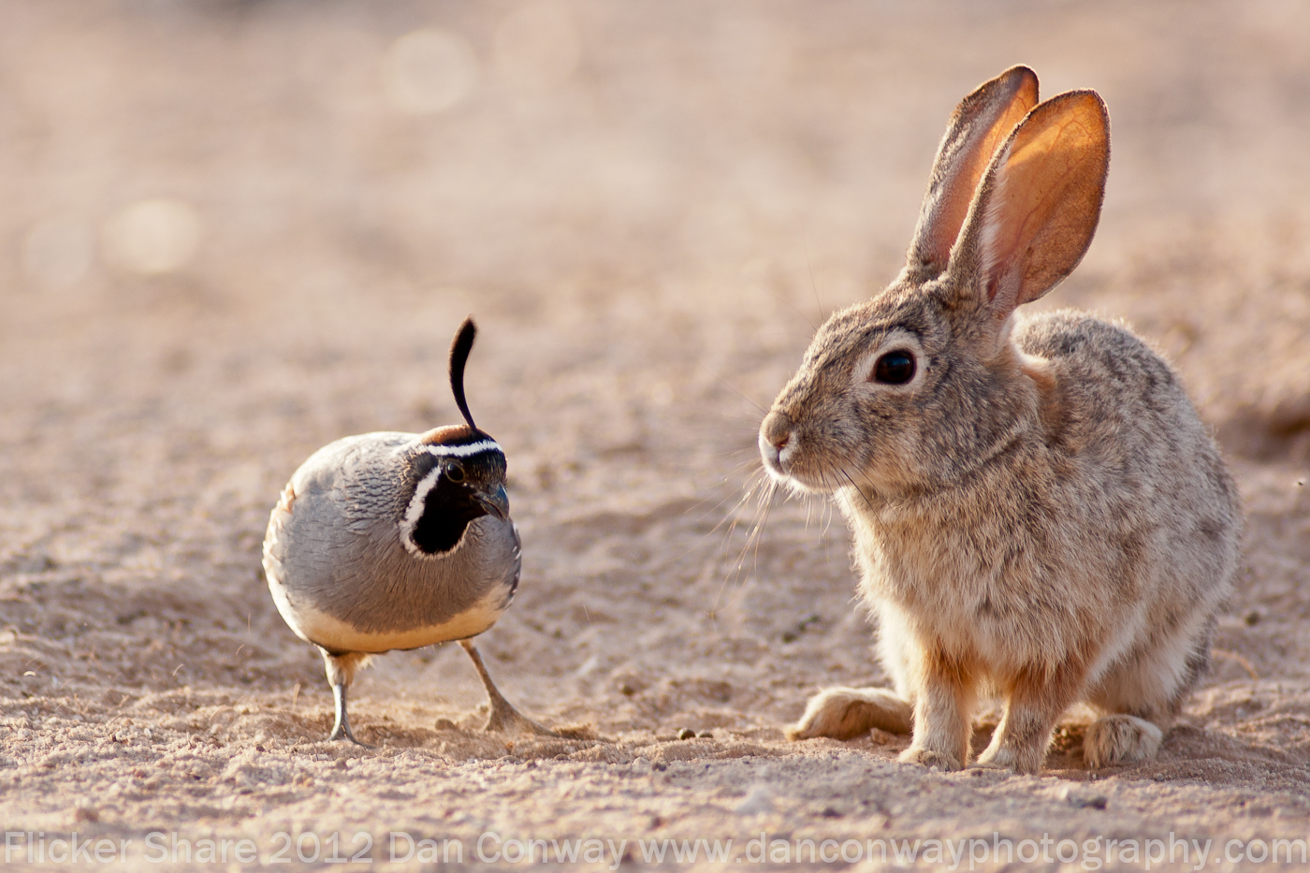
5 Key Operating Principles of World Café
Create hospitable space
Explore questions that matter
Connect diverse people and perspectives
Listen together for patterns, insights, and deeper questions
Make collective knowledge visible to the group
Photo Credit: Dan Conway, Flickr

Slide 8
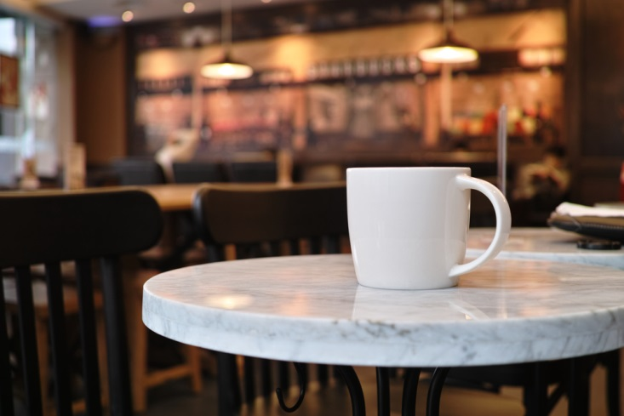
Café Conversations
International movement, started by author Vicki Robin fostering coffee house meetings on a regular basis for interesting communication about relevant issues amongst strangers in the Socratic tradition of respectful dialogue.
Started in Seattle, after 9/11.

Slide 9

Conversation Café
3 friends ran an experiment – each sat in a different café once a week and invited whoever was there to dialogue about things that really mattered.
Topics centered around democracy, critical thinking, and neighborliness
Café conversations helped diverse people process 9/11; themes of healing and prevention
  Asked questions at tables such as “What can civic organizations do? What can faith-based organizations do?
Photo Credit: Justin Lincoln, Flickr

Slide 10

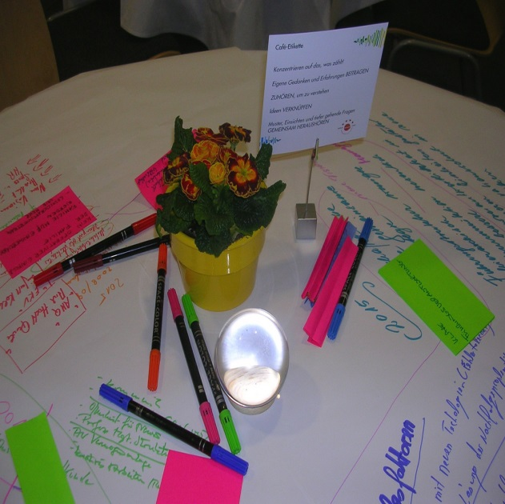
Five Components of World Café
Setting
Welcome and Introduction
Small Group Rounds with Table Hosts
Questions
Harvest
Source: http://www.theworldcafe/com/method.html
http://www.flickr.com/photos/8007839@N02/5253358565/sizes/l/

Slide 11
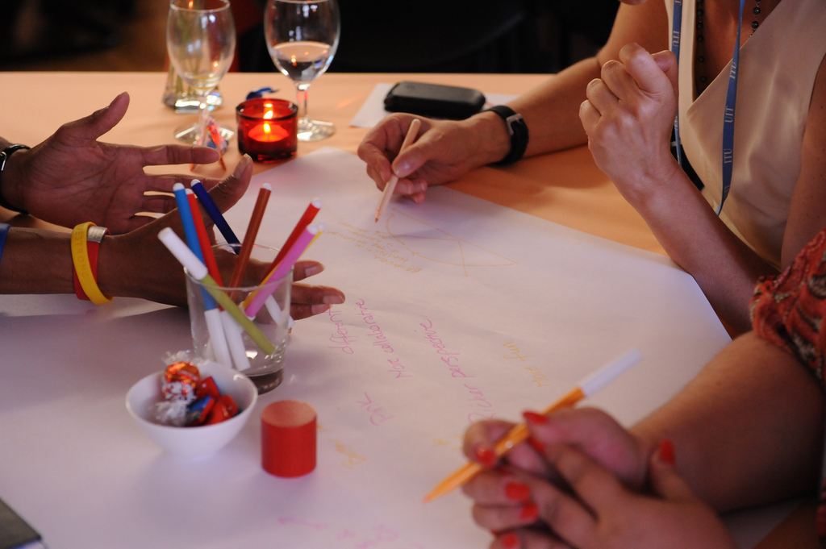
Listening, Recording, Inviting, Focusing, Doodling, Opposing
Photo credit: http://www.flickr.com/photos/itupictures/7554741094/sizes/l/

Slide 12
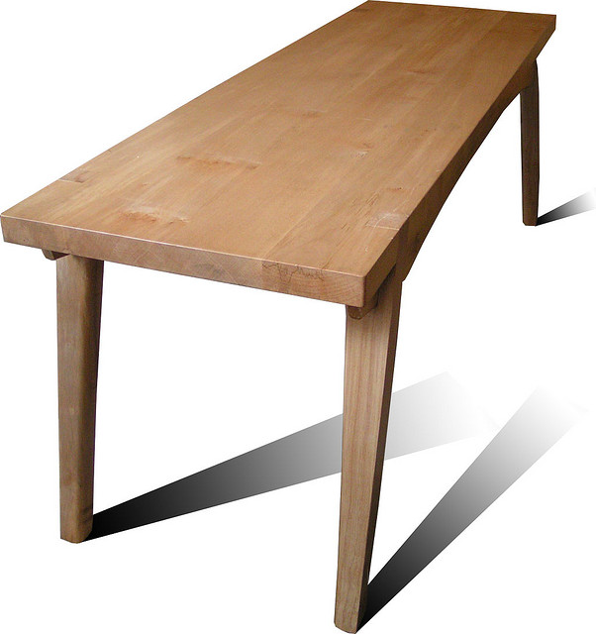
Today’s Table Topics
What is sacred about the middle school ideal?
How do we carry that ideal into the future?

Slide 13
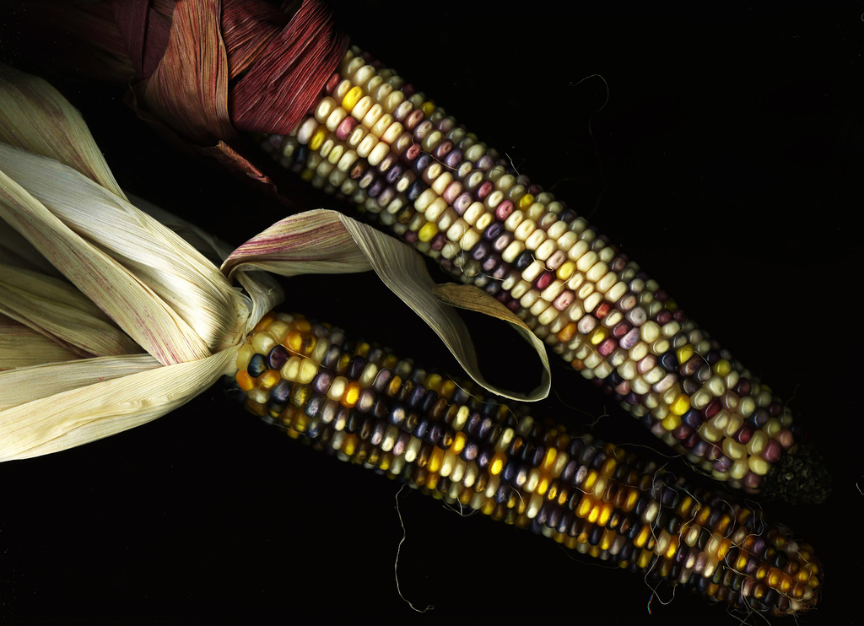
Harvest
Opportunities
Challenges
Considerations

Slide 14

Ideas for Using World Café to Cultivate Courageous Conversations
Participants share

Slide 15
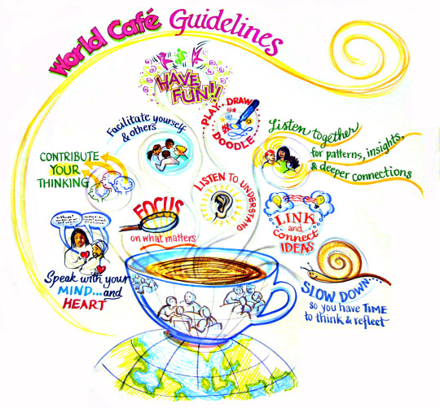

Slide 16
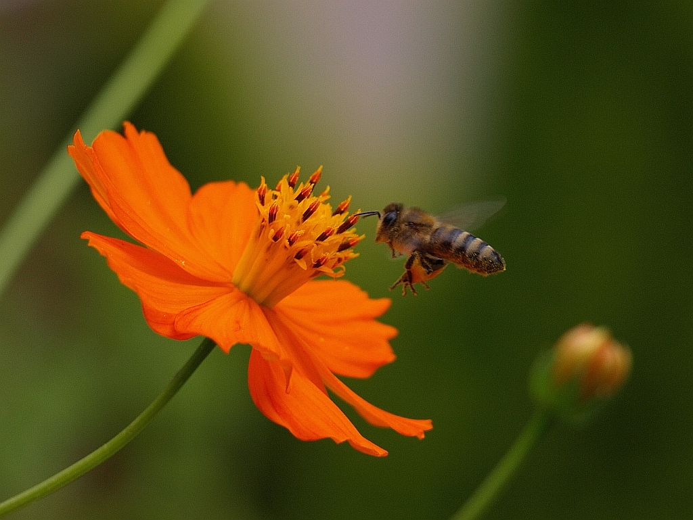
Café Hosting Tips
Set up café-style tables or another relaxed setting.
Provide food, beverages, music, art, natural light, and greenery.
Encourage informal conversation focused on key questions.
Allow time for silence and reflection.
Encourage members to “cross-pollinate” ideas and insights across groups.
Have materials available for visually representing key ideas – markers and paper.
Weave and connect emerging themes and insights.
Honor the social nature of learning and community building.
Help members notice that individual conversations are part of and contribute to a larger field of collective knowledge and wisdom.
Photo Credit: Minas Lamprou, Flickr

Slide 17
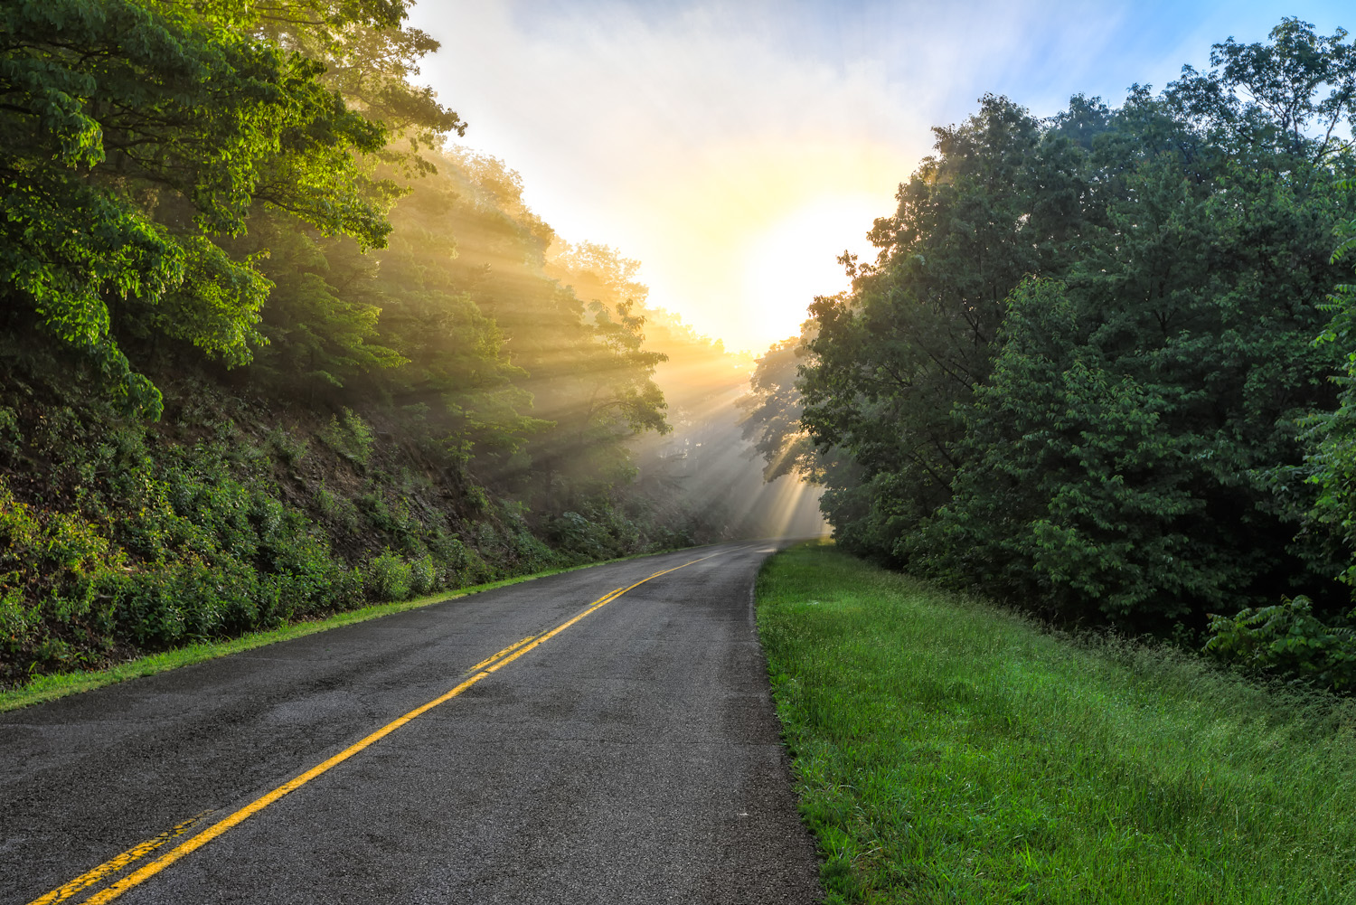
Questions for Consideration
How might I use cafe conversations in my classroom?
How would I modify this method to work for me, my content, and my students?
How might I use cafe conversations in my role as a colleague and teacher leader?
How might I use cafe conversations in my role as a community member and advocate for education and students?
Photo Credit: Kay Gaensler, Flickr

